Slide 1
The Battle of the Neighbourhoods
Applied Data Science Capstone by IBM/Coursera
Tanvik V P

Slide 2
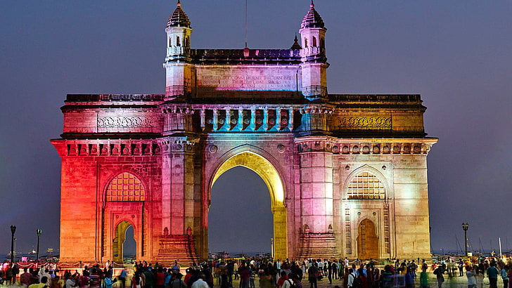

Introduction
Mumbai (previously known as Bombay) is the biggest metropolis of India. A city that is full of life and is also known for its well-known tourists' places, commercial hubs restaurants and government bodies. It is also known as the financial capital of India. The city is located on the western part of the India and is the capital of Maharashtra.
Restaurants across the city are in cahoots to bring out the food connoisseurs with a range of food showcasing the art of fine dining to mouth-watering street food. The dining experience at an upscale restaurant in Mumbai is the same as elsewhere in the world
Whenever a person searches for a venue in a new city, they’re highly interested in the best places that the city has to offer. The person might want to know how good a given restaurant is or the price range it falls under. This extra information would help decide which venue to choose amongst the many venues in the city. Combining the location of the venues in the city with their price and rating information would surely help visitors in a city make better informed decisions about the places they should visit.

Slide 3


Business Problem
The aim of the project is to find places in South Mumbai, India based on their rating, reviews and prices. As we show you various venues of the busiest city in India and lots of places to hangout, to help visitors select the restaurants based on their interests.
The main purpose of this Project is to summarize a report, focusing to find out the important reasons that influence consumers preferences and choices related to specialty cuisine restaurants in South Mumbai. Consumers need information to make their decision in regard to purchasing or treating themselves with a good meal.
Here, we'll identify places that are fit for various individuals based on the information collected from the two APIs and Data Science. Once we have the plot with the venues, any consumer/company can launch an application using the same data and suggest users such information.

Slide 4

Target Audience
The concept of theme-based restaurant is growing at a very fast pace. Every entrepreneur wants to be different from the rest so that a new element can be presented to the guests. Distinction is seen in form of cuisine offered, décor, menu designing, overall concept etc. Customers have very high demands, fulfilling of which can make a restaurant successful in the business. Since most guests are from upper-middle class to rich category, they are likely to be the ones to try new cuisines. It would be good for the restaurant owners/managers to know what people want and what they are searching for.

Slide 5
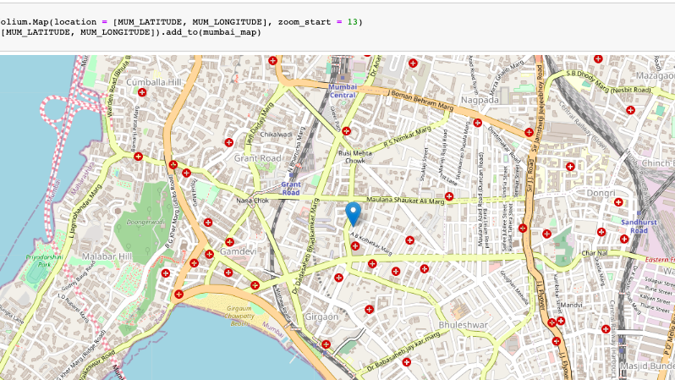
Gathering the Data
To begin with the data ingestion, Lets look at the map of South Mumbai. We will collect the data using 2 api's 1.Zomato Api 2.FourSquare Api. As FourSquare does not have much influence in India, We shall combine it with Zomato API to get a wide range of data. From Foursquare API (https://foursquare.com/developers):
I retrieved the following for each venue:
Name: The name of the venue.
Category: The category type as defined by the API.
Latitude: The latitude value of the venue.
Longitude: The longitude value of the venue
From Zomato API (https://developers.zomato.com/api) :
Name: The name of the venue.
Address: The complete address of the venue.
Rating: The ratings as provided by many users.
Price range: The price range the venue belongs to as defined by Zomato.
Price for two: The average cost for two people dining at the place. Conversion of PF2 is by getting average price per person by multiplying by 2.
Latitude: The latitude value of the venue.
Longitude: The longitude value of the venue.

Slide 6

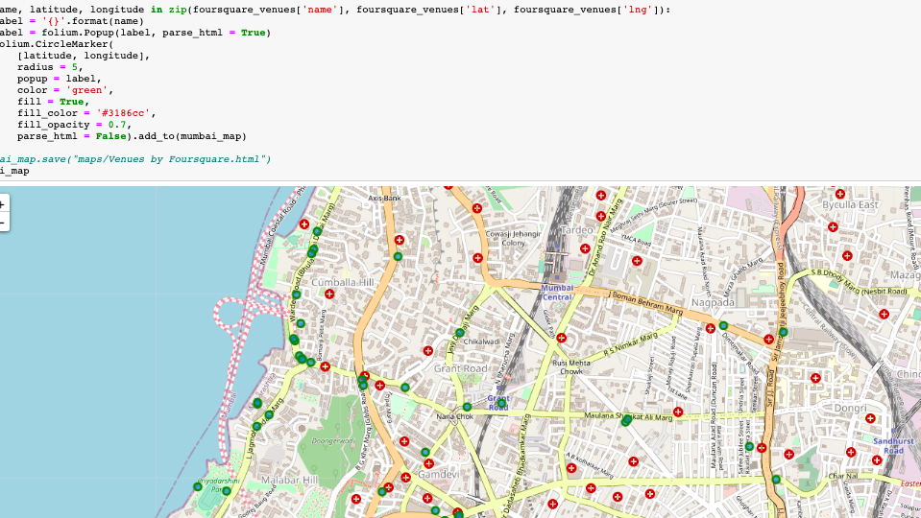
Data Cleansing and Merging Foursquare and Zomato API’s
Combining the data set of FourSquare and Zomato API using latitude and longitude values of each corresponding venue
calculating the difference between the corresponding latitude and longitude values and see if the difference is less than 0.0004 which should ideally mean that the two locations are same
The final cleansed data set of 76 venues when combined is as shown in the map.

Slide 7
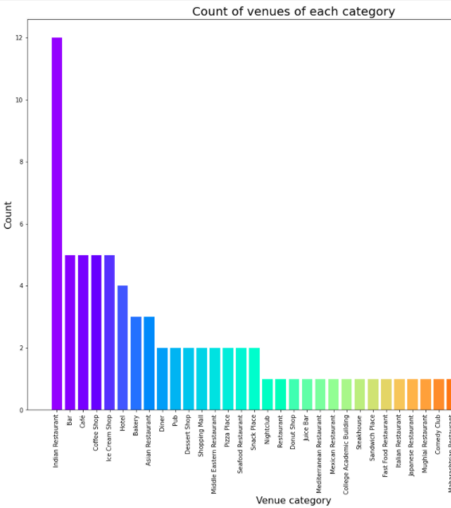
Categories
We have various types of venues in the final dataset. We will look at the venues and check which are the majority venue categories in the list
The below chart shows us the count of venues grouping by the type of restaurants.
In this chart we can see the majority venues are Indian restaurant, and at second comes Bar, Cafe, Coffee shop and Ice cream shops. So, if as a tourist, you're looking for these places, you're in luck.

Slide 8
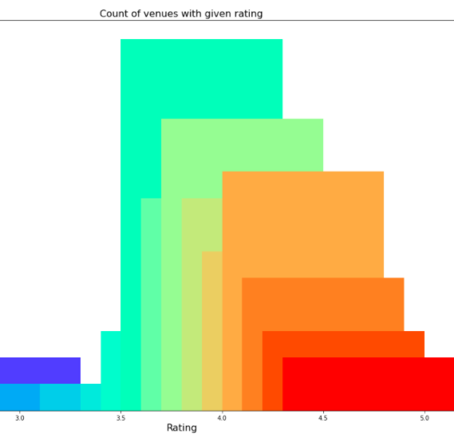
Rating Average Ratings Bar chart:
Rating of a venue is an important factor on which a visitor decides whether it is worth it to visit the place. To get to this, we will first see what is the average rating for all the venues in the city. Next, we will plot the venues on the map and colour code them.
We'll first identify the various rating values and plot them as a bar plot with their counts to see the most common rating
From the above chart we can see that the majority of places has rating from 3.5 to 4.3. For this creating bins for the rating would be a good choice and would be easier to cluster.

Slide 9
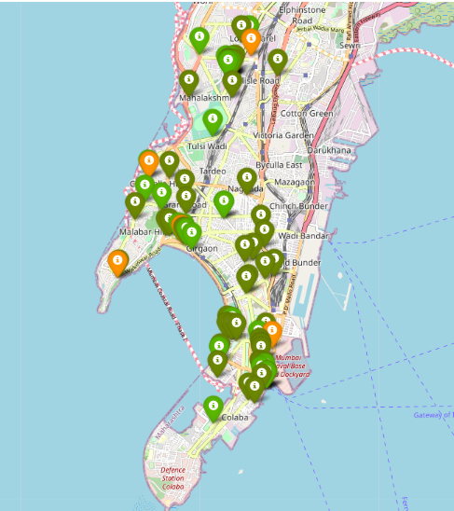
RatiNG Map based on Rating/Reviews:
Red : 1 to 2 (Very low Rating)
Orange : 2 to 3 (Average Rating)
Green: 3 to 4 (High Rating)
Dark Green: 4 to 5 (Very High Rating)
As you can see from the map that there is no places with Red(very low rating), there are 4 places with Orange (Average rating) and many places with Green(High) and Dark Green (Very high )rating.

Slide 10
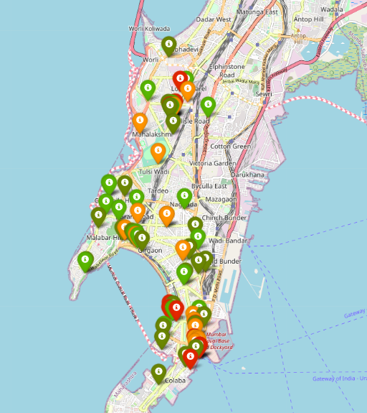
Rating Map based on Price Range:
Red : 4.0 (Very High Price)
Orange : 3.0 (High Price)
Green: 2.0 (Average Price)
Dark Green: 1.0 (Very low Price)
Venues with Red has high price range, followed by orange with high price and Green and Dark Green with low price ranges.

Slide 11
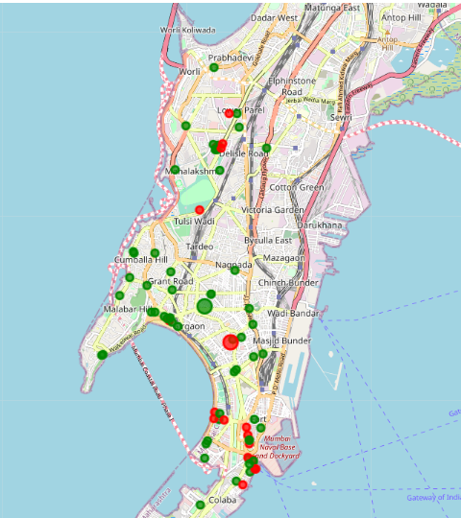
Clustering
We will now cluster all these venues based on their price range, location and more to identify similar venues and the relationship amongst them. We'll cluster the venues into two separate groups.
Here we can see the clusters near Mumbai Naval base has relatively more price than the western side of the naval base.

Slide 12

Result and Discussion
Based on our analysis above, we can draw a number of conclusions that will be useful to aid any visitor visiting the city of Mumbai, India
After collecting data from the Foursquare and Zomato APIs, we got a list of 168 different venues. However, not all venues from the two APIs were identical. Hence, we had to inspect their latitude and longitude values as well as names to combine them and remove all the outliers. This resulted in a total venue count of 76.
Finally, through clusters we identified that there are many venues which are relatively lower priced but have an average rating of 4.01. On the other hand, there are few venues which are high priced and have average rating of 4.28.

Slide 13
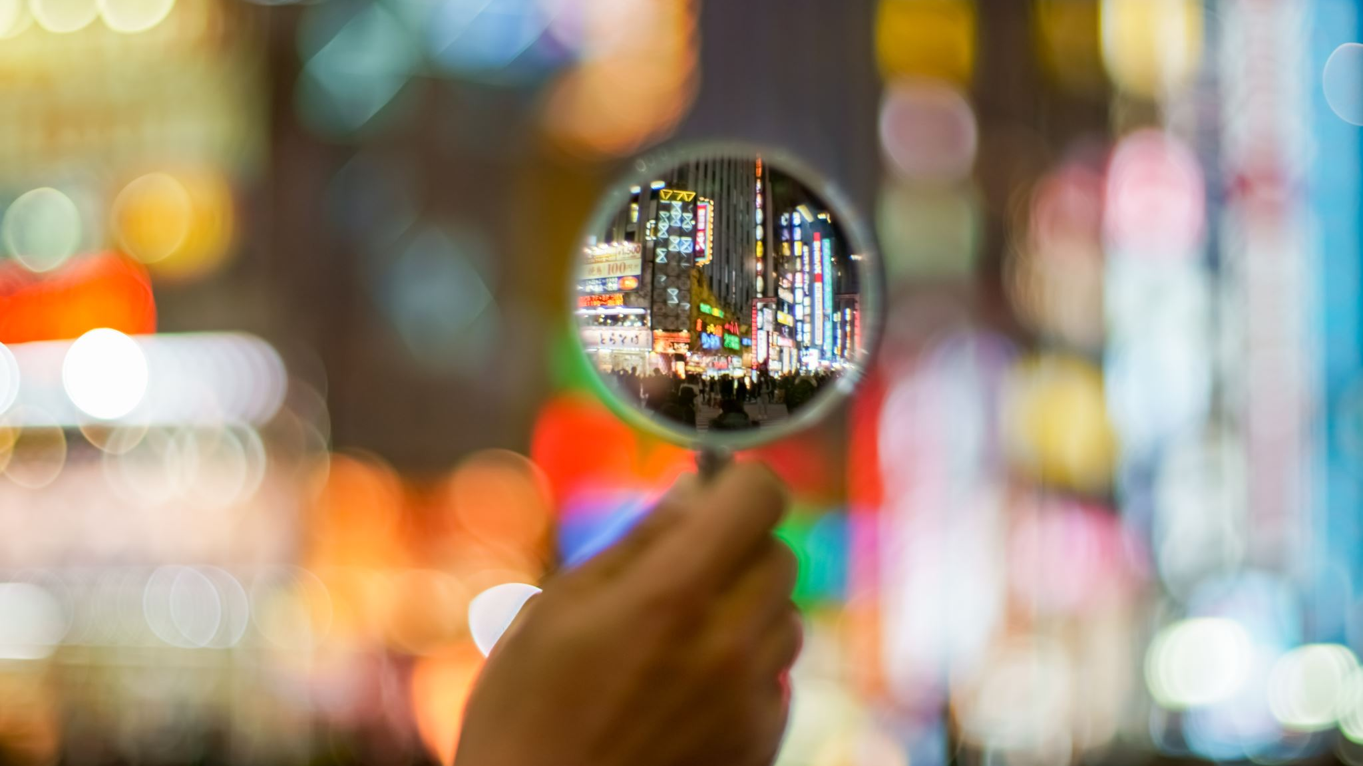
Conclusion
The purpose of this project was to explore the places that a person visiting to South Mumbai . The venues have been identified using Foursquare and Zomato API and have been plotted on the map. The map reveals that there are so many places where one can visit during his stay in South Mumbai. Based on the visitor's venue rating and price requirements, they can choose the places.

Slide 14
Author
Tanvik V P
Data Analyst and Database Senior Developer - Accenture

